Slide 1



UIWear: Easily Adapting User Interfaces for Wearable Devices
Jian Xu, Qingqing Cao, Aditya Prakash, Aruna Balasubramanian, Donald E. Porter
Lab

Slide 2
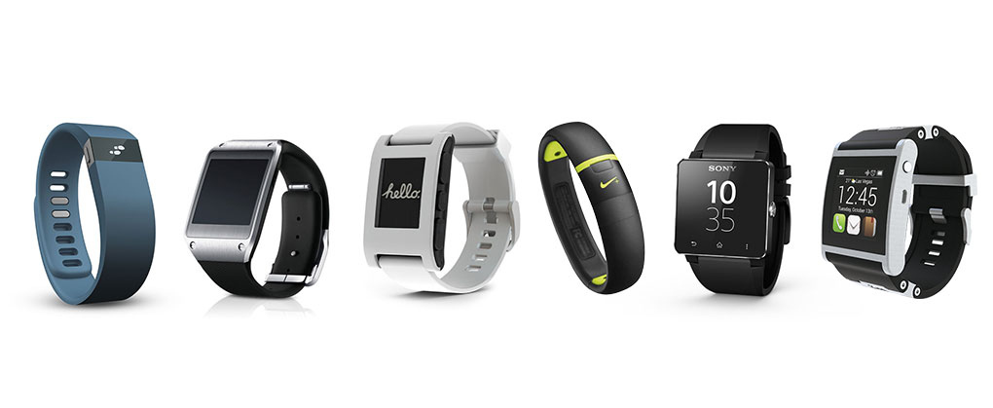
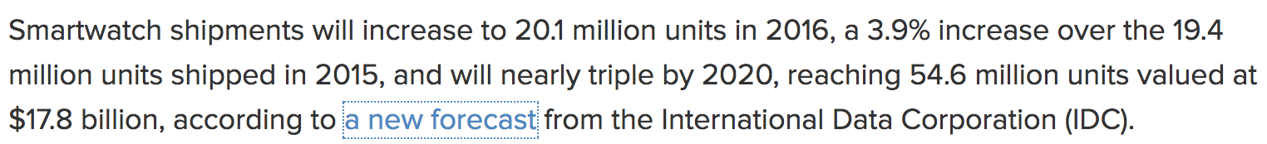
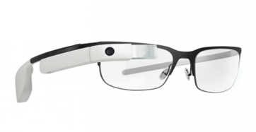
Introduction
Wearable devices
are becoming a major growth sector
for computing…
https://www.techrepublic.com/article/smartwatch-sales-to-hit-17-8-billion-in-2020-but-business-use-lagging/

Slide 3
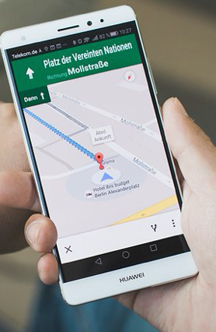
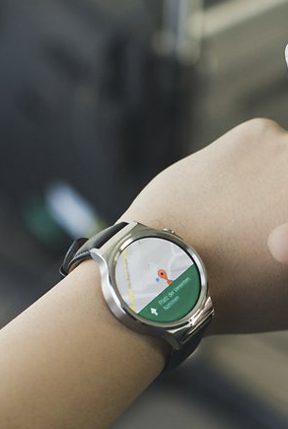
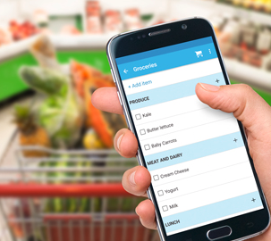
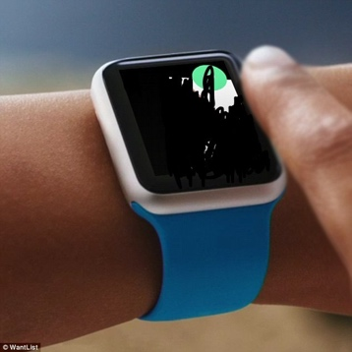
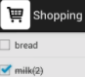
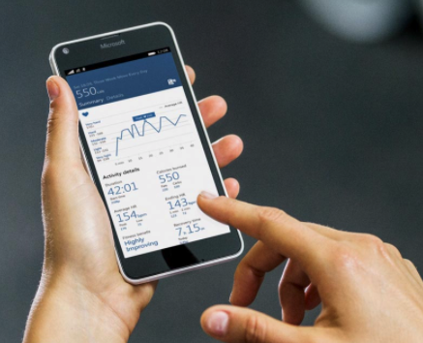
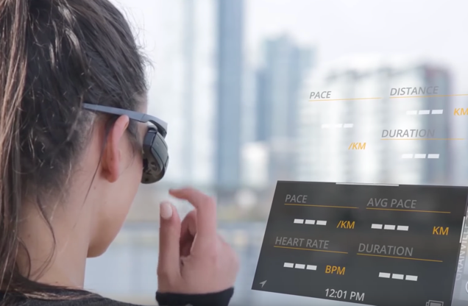
Wearable use cases

Slide 4

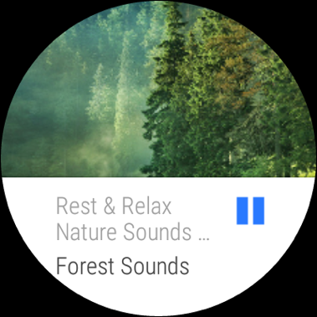
A Dominant model for wearable apps: Companion app
ImageView => Card
1. Companion app mirrors and retailors smartphone UI
TextView =>
Card TextView
Companion
ImageButton => Card ImageView
Spotify app

Slide 5


A Dominant model for wearable apps: Companion app
1. Companion app mirrors and retailors smartphone UI
2. User action on watch relayed to phone
UI updates
User action
Companion
Spotify app
Notes:
Aruna: Change the pause button to play

Slide 6
Survey: Top 100 apps in AndroidWear
App Category | Percentage | Examples
Mirrors UI and performs no local computation | 78% | Spotify, Weather
Standalone | 10% | Google Translate, Talkback
Collects local data | 6% | Fit, WeChat
Performs some local computation | 6% | Outlook, Google Music
Companion
Apps
Notes:
Banner..

Slide 7


Problem: Writing companion apps is tedious
Lines of Code
Lots of popular apps do not have companions…

Slide 8

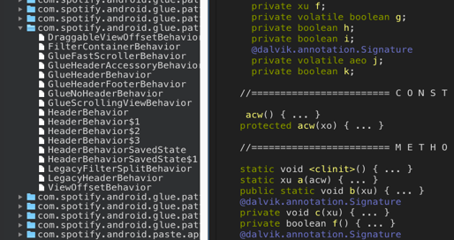
Deconstructing Spotify companion app
Total > 10000 LoC (excluding libraries)
Create UI widgets
> 4000 LoC
Network
> 4000 LoC
Data
Structure
< 1000 LoC
Takeaway:
Code entangles UI design with UI management
Most development effort on app-agnostic tasks
Notes:
Creates native widgets to display on the wearable UI and updates the UI (> 4000 LoC)
Implements a custom RPC protocol to exchange user input and data with the smartphone (>4000 LoC)
Create basic data structures and utility classes (<1000 LoC)

Slide 9
UIWear Goal:
Easily build companion apps with
minimal developer effort

Slide 10
UIWear Key Idea
Decouple UI design from UI management
Developer writes simple Metaprogram
(considerably lower effort)
UIWear creates companion
app, performs UI management

Slide 11
UIWear Architecture
Metaprogram: UI Design specified by a human
Compiler: Compiles metaprogram to UICompanion* app
UIWear runtime: Relays UI events from wearable to phone and performs UI updates
Similar to developer-written app, but generated by UIWear
Common thread : Leverage UI abstraction
(1) Extract UI model, (2) Retailor UI model , and (3) Sync at the UI layer

Slide 12

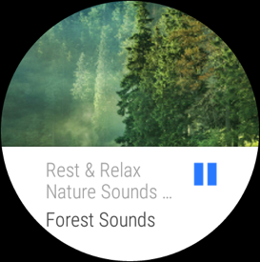
UIWear Compiler and Metaprogram
Meta
Program
UI
Abstraction
UI
Retailoring
UIWear
Compiler
UICompanion
App
Phone app

Slide 13
Challenge:
How to abstract the UI from
off-the-shelf apps?

Slide 14


Possible Solution:
Extracting UI from hardware buffer
The app’s UI is made up of
several UI elements

Slide 15
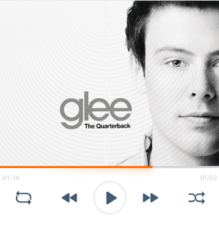
Possible Solution:
Extracting UI from hardware buffer
RDP protocol
Extracting UI from hardware buffer is too late, since semantics are LOST!
UI elements cannot be retailored

Slide 16

UIWear leverages UI trees
UI Tree is the Intermediate Representation of UI
UI trees can be extracted using Accessibility API
Root
RelativeLayout
FrameLayout
FrameLayout
ImageView {Showcontext menu}
TextView: 3:49
SeekBar
TextView: 16:38
ImageButton {Shuffle}
ImageButton {Previous}
ImageButton {Pause} id = btn_play
ImageButton {Next}
ImageButton {Repeat}
ImageButton {Close}
TextView: Playing from Playlist
LinearLayout
TextView: Nature Noise by Spotify
ImageButton{Queue}
RecyclerView
ImageView
ImageView(id=cover_art_carousel)
ImageButton {Add to Your Music}
LinearLayout
TextView: Forest Sounds id= text_album
TextView:Rest & Relax Nature Sounds Artists id = txt_cell_subtitle_normal
LinearLayout
FrameworkLayout
ImageView

Slide 17
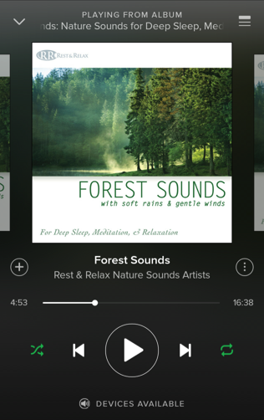
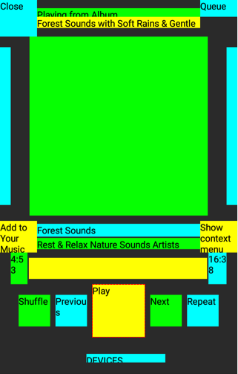
Limitations of accessibility API
The accessibility API does not extract image data from UI
UIWear augments existing accessibility API to extract images on-demand.
UI Tree extracted
by accessibility API

Slide 18
UIWear Meta Program specification
Which UI elements are mapped to wearable
How UI elements are retailored and placed

Slide 19
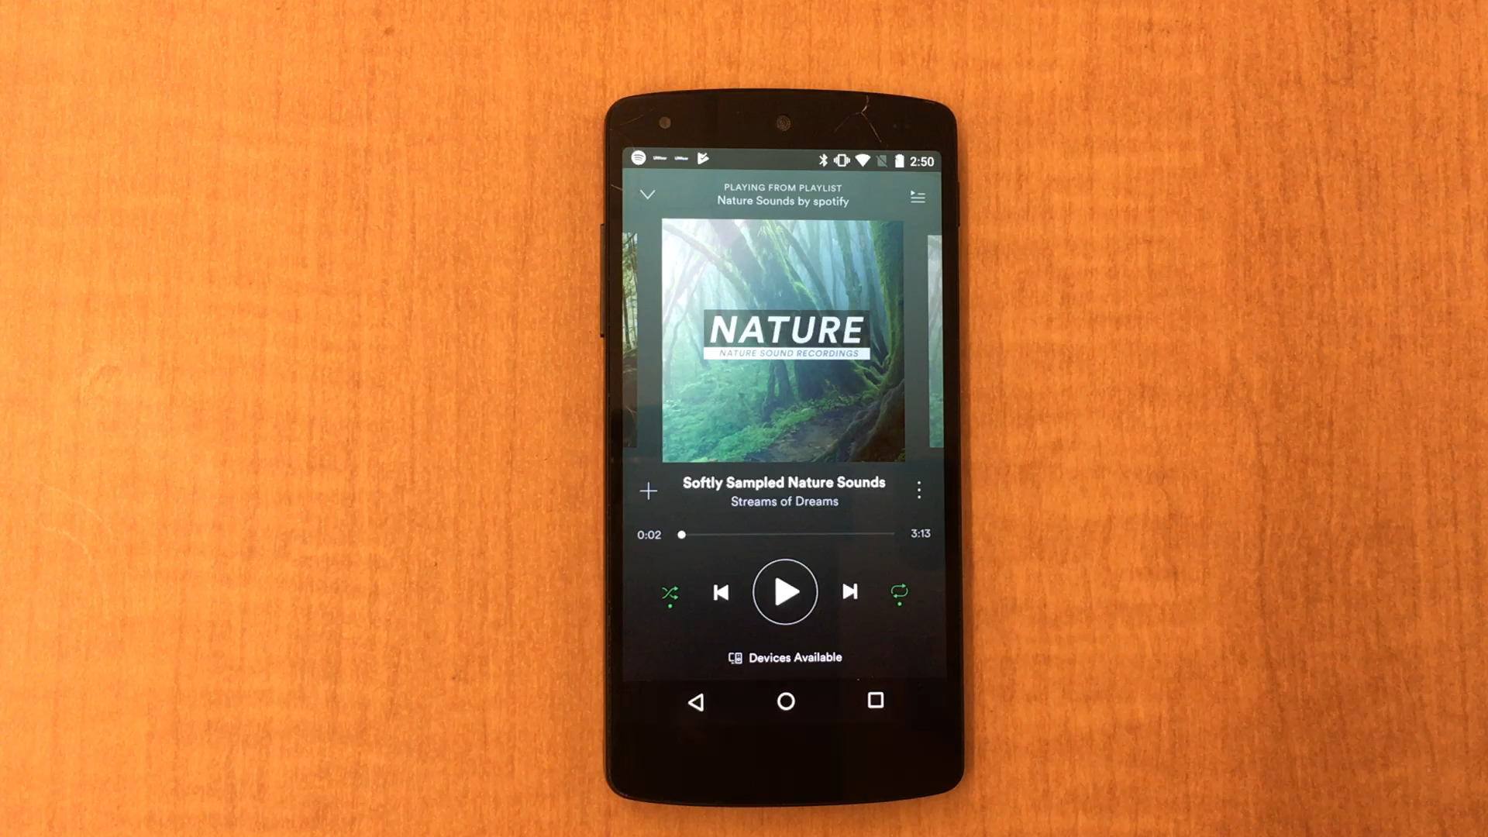
Meta Program: Choosing UI elements to map
Notes:
TODO: faster

Slide 20
Meta program: UI placement and retailoring
<wearable.view.CardScrollView>
id="@+id/backgroundID"
layout_width="match_parent"
layout_height="wrap_content"
layout_box="bottom">
<wearable.view.CardFrame>
<TextView
id="@+id/titleID"
layout_width="match_parent"
layout_height="wrap_content"/>
<ImageView
id="@+id/iconID"
layout_width="30dp"
layout_height="30dp”/>
<TextView
id="@+id/albumID"
layout_width="match_parent"
layout_height="wrap_content" />
</wearable.view.CardFrame>
</wearable.view.CardScrollView>
Meta Program for Spotify
Notes:
You can see the entire code for spotify in metaprogram just in one page here.

Slide 21
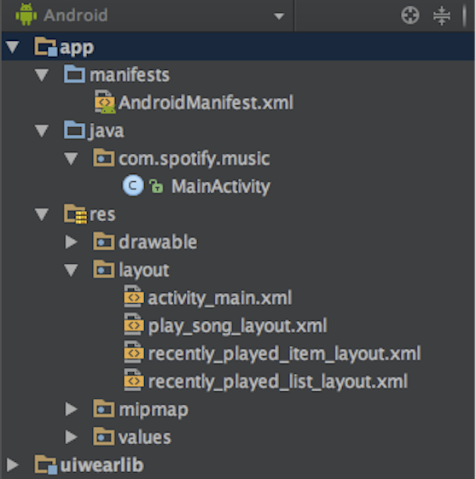
Compiling UICompanion apps from metaprogram
Generated
by parsing
Meta Program
UIWear Stub

Slide 22


UIWear Runtime: Sync at UI layer
Poll
UI
Change
UIWear Phone Proxy
User Input
Through Accessibility
Phone
UIWear
Wearable
Proxy
UI Update
User Action
Wearable Device

Slide 23
Challenge:
Phone OSes destroy the UI (and the UI Tree) when application is in background

Slide 24
UIWear idea:
Destroy graphics stack but keep UI tree
(no negative effect on power or performance)

Slide 25
UIWear behavior when app moves to background
App
(moved to background)
UI Tree node
Stop
Stop rendering
Accessibility Service
Graphics stack

Slide 26
UIWear behavior when app moves to background
App
(moved to background)
UIWear
UI Tree node
Non-stop
Stop rendering
Cached UI tree
Accessibility Service
Graphics stack

Slide 27
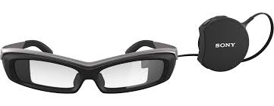

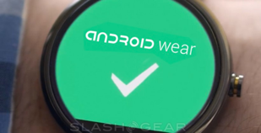
Implementation
Android OS, AndroidWear, and Sony Smartglasses
20 UICompanion apps
Metaprogram mimics developer-written companion app
Picked from top 150 apps with different categories and popularities

Slide 28
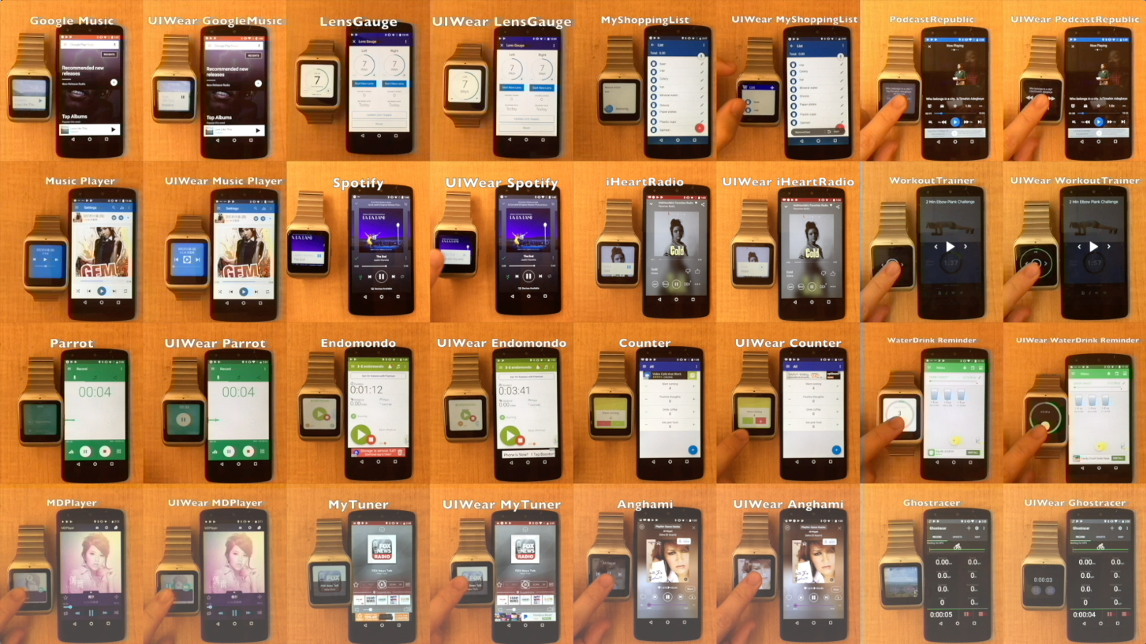
Generated UICompanion apps
Notes:
115 1pm

Slide 29
Evaluations

Slide 30
Comparing Lines-of-Code
LoC of meta program covers all activities
App (downloads) | Companion LoC | Meta prog. LoC
WorkoutTrainer (10M) | 2265 | 36
Anghami (10M) | 2,263 | 79
BandLab (500M) | 1,802 | 8
Spotify(100M) | 10,215 | 47
Endomondo (10M) | 6,522 | 18
Ghostracer (10K) | 5,324 | 95
HydroCoach (1M) | 4,022 | 12
iHeartRadio (50M) | 7,926 | 96
UICompanion apps require an order-of-magnitude fewer developer-written LoC
Notes:
Those metaprogram includes all the code that cover all the activities

Slide 31
Comparing Latencies (UI Update Time)
UI Update time: The time to update the watch UI in response to an update on the phone
Methodology
Use systrace tool to capture timestamps
Automate UI interactions for repeatability

Slide 32
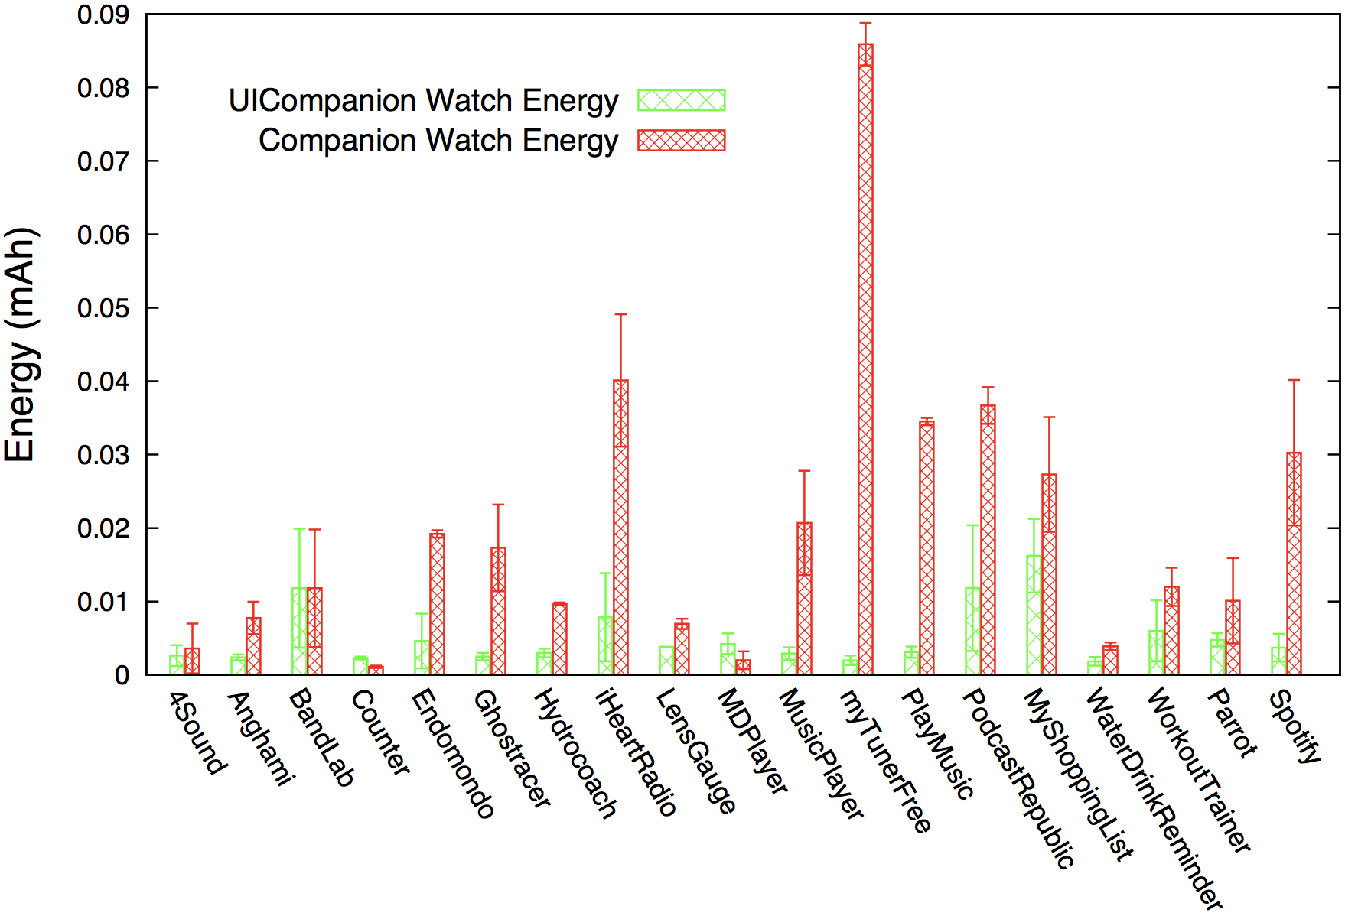
Energy Consumption on the watch
UICompanion apps have comparable performance in terms of energy consumption on phone, CPU, latency

Slide 33
User studies
Metric | UICompanion Better or Equal | AndroidWear Better
Functionality | 78% | 22%
Look and feel | 74% | 26%
On average, each subject created a working meta program <= 16 minutes
Notes:
The subjects are ranging from programming beginners to professionals.

Slide 34
Other Evaluations
Keeping the UI Tree active does not affect power or performance
UIWear can be used to create
Apps on smart glasses
Third-party companion apps

Slide 35
Conclusions
Contributes a new design point that decouples the application logic and UI design
Provides a much easier way to generate a UICompanion app with few LoC
The UICompanion app has comparable performance and power
http://sbuwear.cs.stonybrook.edu/
https://github.com/SBUNetSys/UIWear

